Slide 1
Batteries and Fuel Cells
Lesson 8 & 9

Slide 2
Reactivate
‌Order these metals in terms of reactivity with the most reactive first: copper, zinc, magnesium.
‌Name the type of reaction: Mg + FeSO₄ → MgSO₄ + Fe
‌Which substance is oxidised in question 2?
Notes:
1. magnesium, zinc, copper
2. Displacement
3. Magnesium / Mg

Slide 3
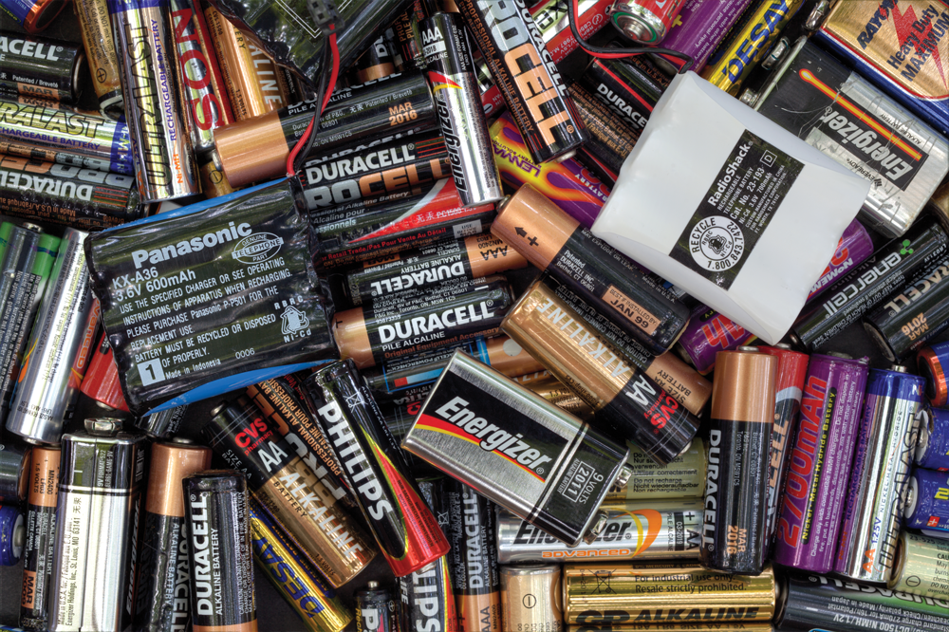
Something to think about
We say we are replacing batteries in household devices.
But are we?
Notes:
A cell contain chemicals which react to produce electricity.
A battery is more than one cell connected in series.
So, when we say we are replacing batteries, we are in fact replacing cells.
When these cells in the device are connected in series, they form a battery.

Slide 4
Learning objectives
Key words
After this topic, you should know:
how to interpret data on chemical cells in terms of the relative reactivity of different metals
how to evaluate the use of chemical cells when given information
how to plan and carry out an investigation of the voltage produced by simple cells using different metals.
battery
cell
electrical cell
electrode
electrolyte
Notes:
Specifications:
4.5.2.1, WS 2.2, 2.6
Differentiate the learning objectives based on the ability of the students:
Explain how potential difference can be changed in a cell Interpret data from an electrochemical cell to determine the reactivity of the metals involved.
Explain why non-rechargeable batteries stop working.

Slide 5
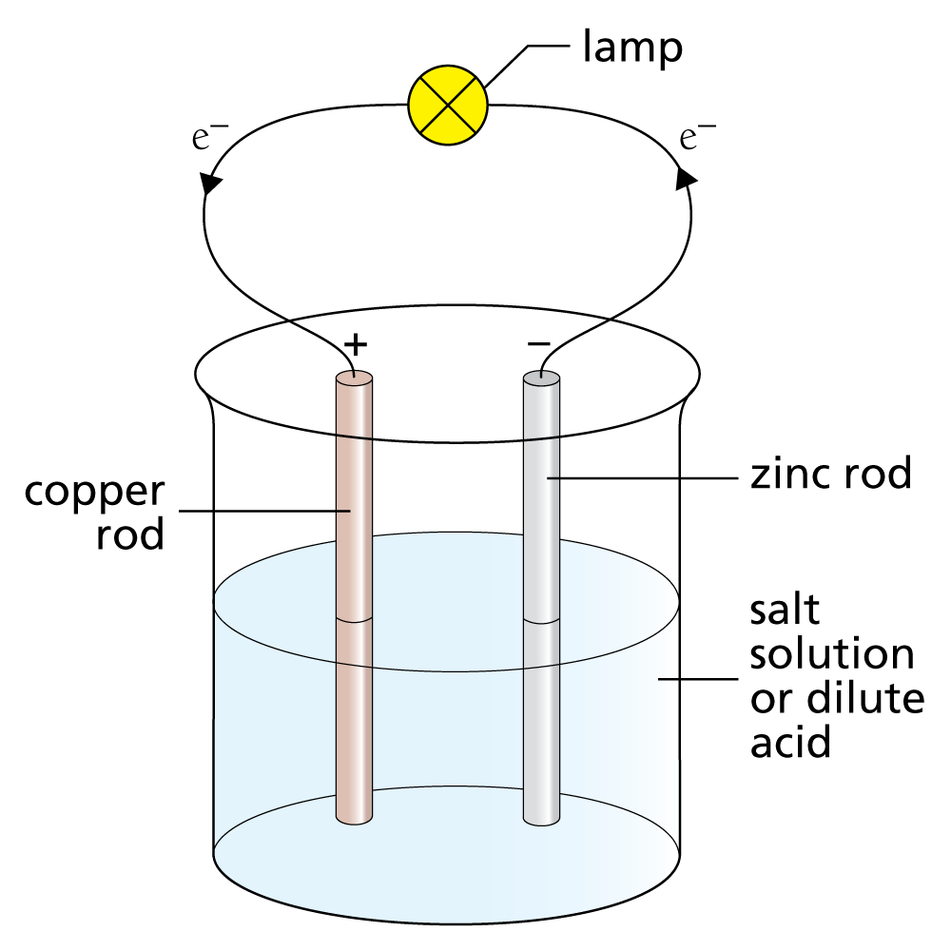
Exposition
The chemistry of cells and batteries is related to the reactivity series.
A redox reaction happens between a metal ion and a different metal atom, creating a potential difference (voltage) that can power a device.
The greater the difference in reactivity of the two metals used, the greater the voltage produced.
Notes:
The diagram shown an electrical cell made from zinc and copper.
The electrons flow through the wire from the more reactive metal (zinc) to the less reactive metal (copper).
So, zinc acts as the negative terminal of the cell, providing electrons to the external circuit.

Slide 6
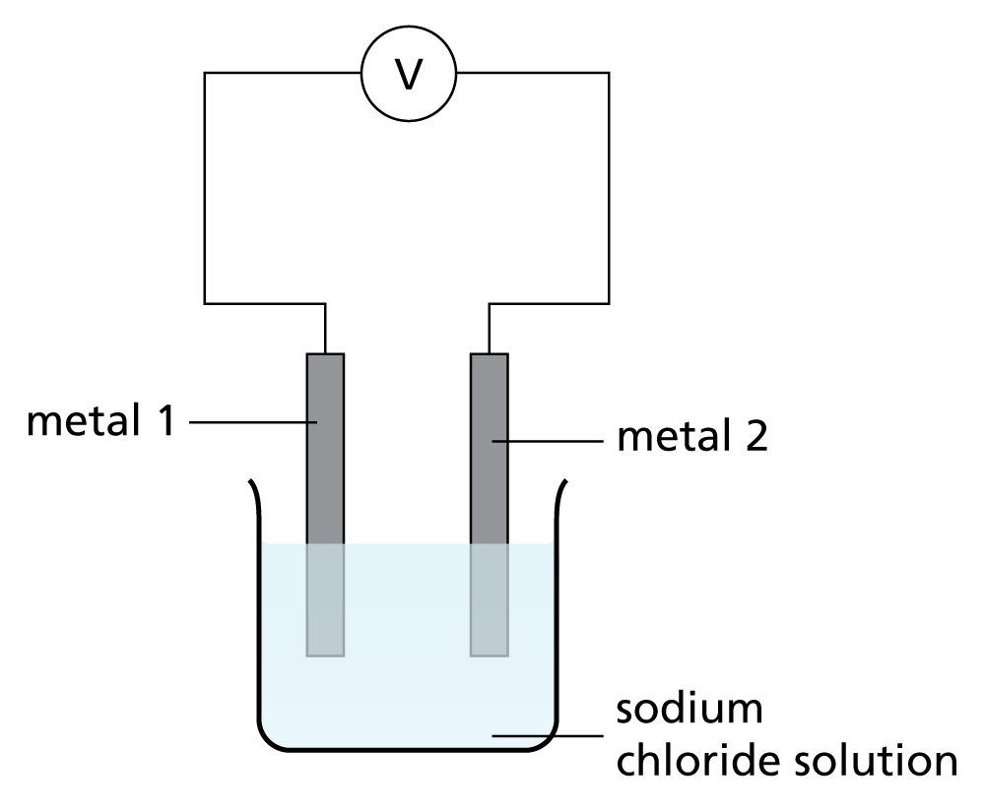
Practical: Chemical cells and batteries
A simple cell can be constructed from two metal electrodes dipped into an electrolyte.
In this activity you will:
investigate the use of simple cells to produce electrical energy
measure the voltage produced using different combinations of metals
find out about different types of batteries and their uses.
Notes:
Highlight this key fact for students to remember – ask them to write it down in big letters or with patterns around it for them to easily refer to.
The greater the difference in reactivity of the two metals used, the greater the voltage produced.
Students can then consolidate this understanding by seeing this in the results of their practical.

Slide 7
Extension
Use your Student book, or other resources, to research the circuit symbols of a chemical cell and a chemical battery.
Explain how the battery symbol can imply how many cells it contains and how they are connected.
Draw an example of a battery using circuit symbols.
Complete the Circuit symbols activity.
Notes:
If students have time after the practical, they can do this simple pieces of research and/or complete the C7.5 Interactive: Circuit symbols activity. Alternatively, this activity could be set as extra, optional or alternative homework.

Slide 8
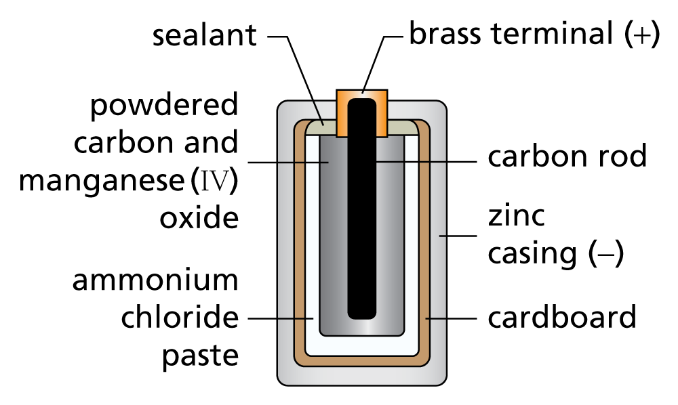
Review
‌What is the difference between non-rechargeable and rechargeable cells?
‌What is the difference between a battery and a cell?
‌How can cells and batteries be recharged?
Notes:
The diagram shows a zinc-carbon dry cell battery which produces a voltage of about 1.5 V but cannot be recharged and is likely to leak if left in an appliance for a long period of time.
If there is time before students tackle the activities described in the teacher guide run through these questions as a whole-class activity to assess students’ understanding and application of energy changes.
If you have time this could be done as a quick quiz using mini-whiteboards.
Answers
Non-rechargeable batteries can only be used once as the chemicals get used up. Rechargeable batteries can be used many times as the chemical reaction can be reversed when an external current is run through the cell.
A battery is more than one cell connected in series, a cell is just made by connecting two different metals in contact with an electrolyte.
Supply an external current and the chemical reactions are reversed.

Slide 9
Homework
Chemical cells can be classified as rechargeable or non-rechargeable.
Make a table to compare the different types of cell.
You should include:
an example of each cell
a brief explanation of how they work.
Do some research about the costs of manufacture and the lifetime of the battery or cell and comment on the environmental impact of their use.
Notes:
Alkaline batteries are examples of non-rechargeable cells.
Batteries in mobile phones, lead-acid batteries (in cars) are common examples of rechargeable batteries.
Non-rechargeable batteries work until one of the reactants is used up and so the chemical reactions stops.
Rechargeable cells and batteries can be used many times as when the chemical reaction is completed, an external current can be applied and the chemical reaction can be reversed. This allows the chemical reactions to take place again in the battery and release electricity.

Slide 10
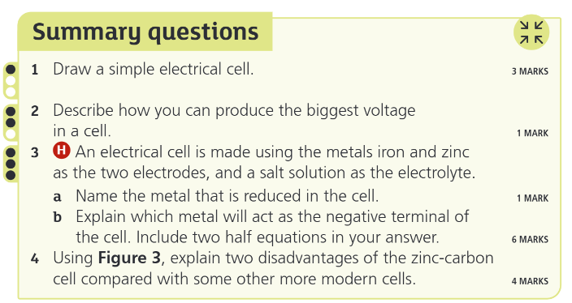
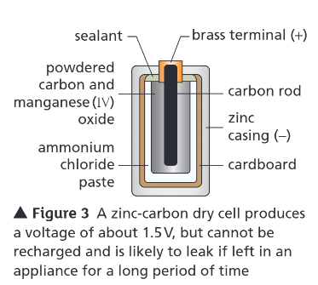
Title – Batteries and Fuel Cells

Slide 11
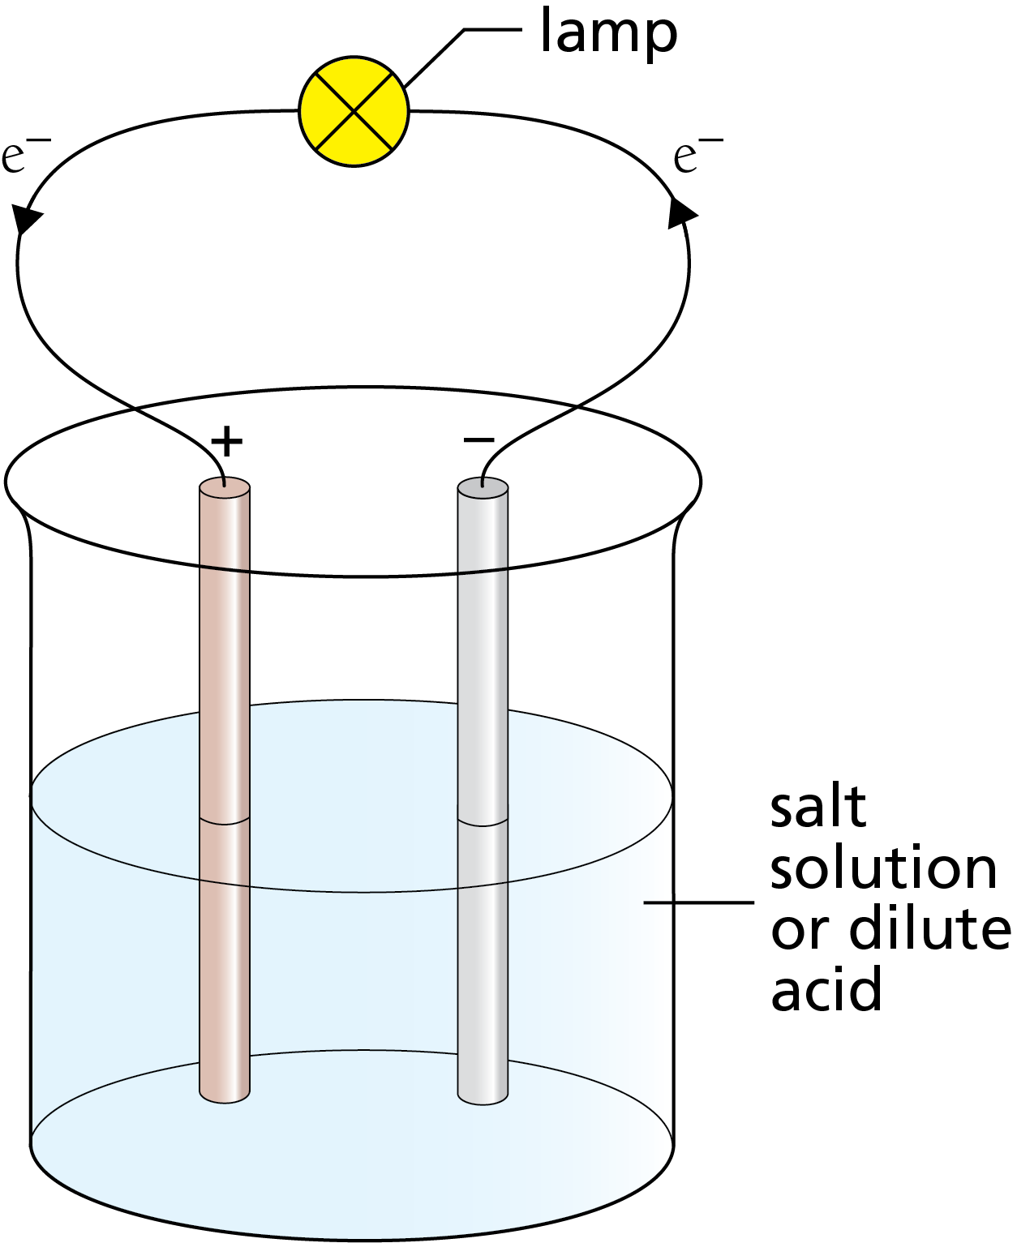
1. Draw a simple electrical cell. 3 marks
Two electrodes made of different metals. [1]
Attached to a voltmeter. [1]
Electrodes dipping in a solution containing ions. [1]

Slide 12
2. Describe how you can produce the biggest voltage in a cell. 1 mark
Select two metals with the greatest difference in reactivity. [1]

Slide 13
3. H An electrical cell is made using the metals iron and zinc as the two electrodes, and a salt solution as the electrolyte. a. Name the metal that is reduced in the cell. 1 mark b. Explain which metal will act as the negative terminal of the cell. Include two half equations in your answer. 6 marks
a. Iron. [1]
b.
Zinc, more reactive than iron. [1]
Greater tendency to lose electrons and form positive ions. [1]
Zinc atoms ⟶ Zn²⁺ ions at negative terminal, donating 2 electrons to iron(II) ions. [1]
Zn ⟶ Zn²⁺ + 2e⁻ [1]
Fe²⁺ ions ⟶ iron atoms at positive terminal. [1]
Fe²⁺(aq) + 2 e⁻ ⟶ Fe(s) [1]

Slide 14
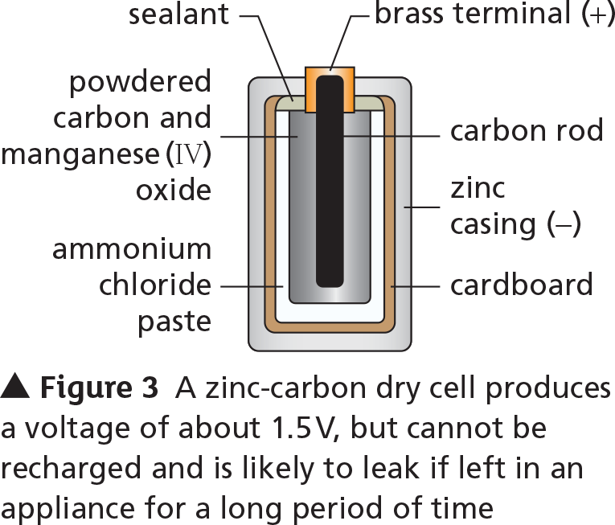
4. Using Figure 3, explain two disadvantages of the zinc-carbon cell compared with some other more modern cells. 4 marks
Once one reactant is used up cell stops working and must be discarded as it cannot be recharged [1]
Prone to leakage if zinc casing is used up (as it changes to zinc ions) and dissolves releasing inner paste from outer casing [1]

Slide 15
Reactivate
‌Complete the equation: 2H₂ + O₂ → ………
‌Why is a hydrogen powered vehicle better than a petrol or diesel vehicle?
‌Give one disadvantage of using hydrogen fuel cells.
Notes:
2H₂O
Doesn’t give out any pollutants / only water whereas petrol and diesel pollute the atmosphere / give out carbon dioxide
Highly flammable / produced sometimes by non-renewable sources / difficult to store

Slide 16
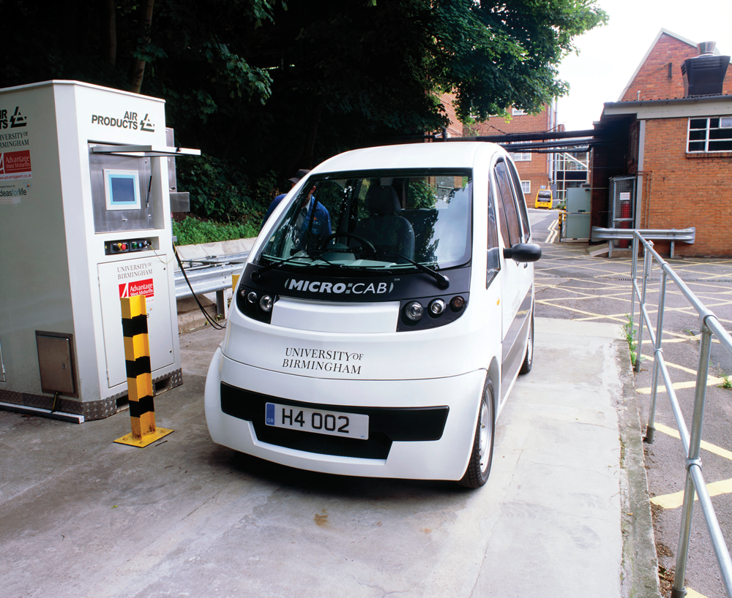
Something to think about
Can hydrogen be used to fuel cars?
Notes:
Using a fuel cell can electrochemically oxidise hydrogen rather than it undergoing a combustion reaction. This is more controlled and has a higher efficiency (more of the stored chemical energy from the hydrogen fuel is transferred into useful energy and less is wasted by heating the surroundings).

Slide 17

Learning objectives
Key words
After this topic, you should know:
how to evaluate the use of hydrogen fuel cells
how to write the half equations for the electrode reactions in the hydrogen fuel cell.
electrode
electrolysis
fuel
fuel cell
Notes:
Specifications:
4.5.2.2, WS 1.4
Differentiate the learning objectives based on the ability of the students:
Explain how a hydrogen fuel cell produces electricity.
List the advantages and disadvantages of hydrogen fuel cells.

Slide 18
Exposition
Hydrogen can be oxidised to form water.
‌Write a word equation for this reaction.
‌Write a balanced symbol equation for this reaction.
Notes:
Use this example to recap key points with students before moving on the main exposition.
Answers
The word equation is: hydrogen + oxygen → water
The balanced symbol equation is: 2H₂ + O₂ → 2H₂O

Slide 19
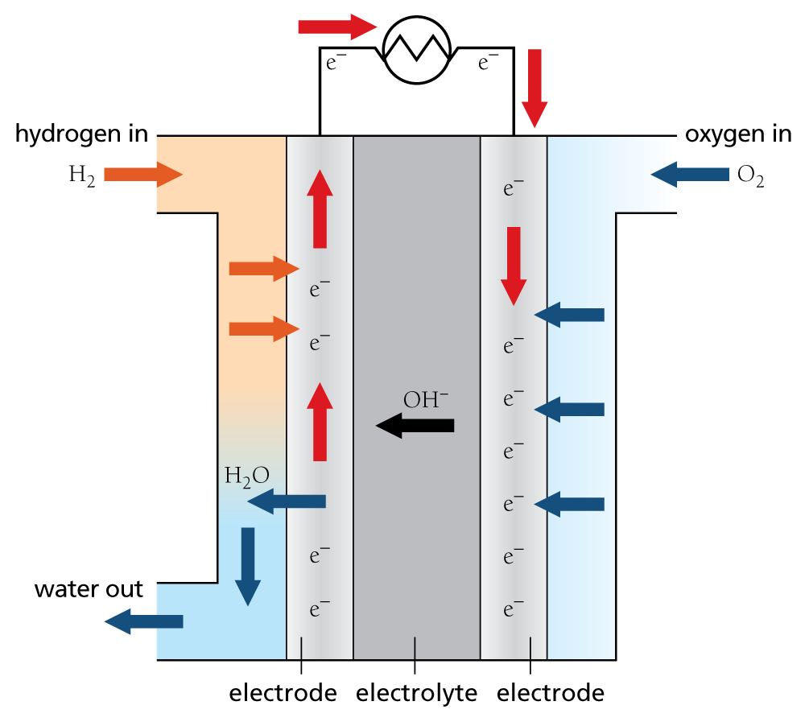
Exposition
An alternative to rechargeable chemical cells is a fuel cell.
A fuel cell produces a voltage by electrochemically oxidising the fuel.
Fuel cells have continual external source of:
fuel
air/oxygen.

Slide 20
Activity: Fuel cells
In this activity you will:
learn how a hydrogen fuel cell works
find out about its applications, advantages, and disadvantages.
Notes:
This sheet could be used as a homework activity.
The questions become more demanding so you can differentiate by allowing students to choose, or be asked to complete, only certain questions.
Fuel cells are fed with an external source of fuel (e.g., hydrogen), plus oxygen or air.
The fuel is oxidised electrochemically within the fuel cell to produce a voltage.
The electricity provided by the fuel cell can be used to run an electric vehicle or to power other equipment.

Slide 21
Extension
Complete the Fuel cells literacy sheet.
In this activity, you will:
learn more about how fuel cells work and how they can be used
consider the advantages and disadvantages of using a hydrogen fuel cell to power a car
answer questions that involve some of the key words and scientific terms.

Slide 22
Review
‌What are the the advantages of fuel cells?
‌What are the disadvantages of fuel cells?
‌What are the chemical reactions in fuel cells?
Notes:
If there is time before students tackle the activities described in the next slide, run through these questions as a whole-class activity to assess students’ understanding.
If you have time this could be done as a quick quiz using mini-whiteboards.
Answers
100% atom economy, hydrogen readily available, only water is mad, renewable, no need to electrically.
Hydrogen is difficult to store, expensive, often hydrogen has to be made with fossil fuels, explosive/highly flammable.
Oxidation/REDOX/electrochemical oxidation

Slide 23
Homework
Modern lifestyles require huge amounts of energy, from heating our homes to powering our cars.
But how can we obtain that energy without contributing to environmental issues?
Research hydrogen as a fuel to produce an informative newspaper article about hydrogen fuel cells.
Notes:
Students can use the Is hydrogen the perfect fuel? WebQuest to guide them in this task.
Students should complete the research and write a balanced article.
They should conclude that hydrogen is the most plentiful element in the universe.
It also makes an excellent fuel because it burns well and produces only water.
Obtaining and storing hydrogen is difficult, even though there is so much of it.
Hydrogen fuel cells appear to be favourable in terms of energy densities and greenhouse emissions but would need huge infrastructures to be in place before they could be used globally.

Slide 24
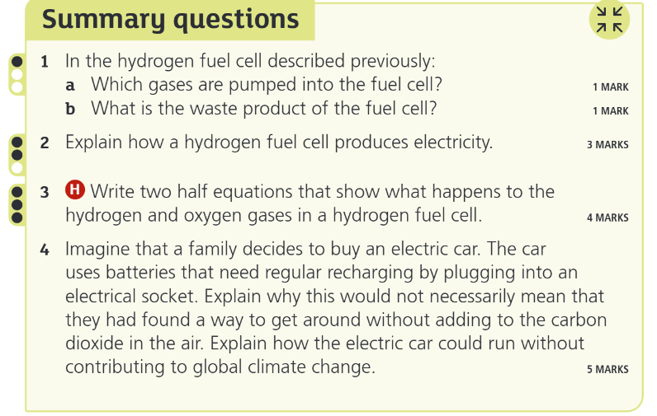

Slide 25
1. In the hydrogen fuel cell described previously: a. Which gases are pumped into the fuel cell? 1 mark b. What is the waste product of the fuel cell? 1 mark
a. Hydrogen and oxygen/air. [1]
b. Water. [1]

Slide 26
2. Explain how a hydrogen fuel cell produces electricity. 3 marks
Hydrogen reacts with hydroxide ions to provide electrons into the circuit. [1]
Oxygen accepts the electrons from the external circuit. [1]
Producing the electric current. [1]

Slide 27
3. H Write two half equations that show what happens to the hydrogen and oxygen gases in a hydrogen fuel cell. 4 marks
2H₂(g) + 4OH⁻(aq) ⟶ H₂O(l) + 4e⁻ [2]
O₂(g) + 2H₂O(l) + 4e⁻ ⟶ 4OH⁻ (aq) [2]

Slide 29
4. Imagine that a family decides to buy an electric car. The car uses batteries that need regular recharging by plugging into an electrical socket. Explain why this would not necessarily mean that they had found a way to get around without adding to the carbon dioxide in the air. Explain how the electric car could run without contributing to global climate change. 5 marks
Electricity to recharge cells from the mains might be produced by burning/combustion. [1]
Of fossil fuel. [1]
However, if electricity from renewable source. [1]
Such as wind power or solar cells. [1]
No carbon dioxide produced. [1]

